Slide 1


WAVELET TRANSFORM
Supervisor: Dr. Lý Quốc Ngọc
Group 9: Hồ Quang Minh - 1211042
Đỗ Đặng Minh - 1311015
Huỳnh Công Toàn - 1311026
Dương Xuân Long - 1311048
Hồ Văn Tấn - 1311058
Notes:
Version: 1.4
Last update: Ocotober 24, 2014

Slide 2
OUTLINE
Fourier Transform
Wavelet Transform
Multiresolution Analysis
Haar Wavelet Transform
Continuous Wavelet Transform
Discreet Wavelet Transform
Wavelet Packet
Wavelet Transform Application
JPEG 2000
Demo
Conclusion

Slide 3
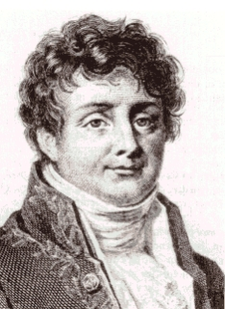
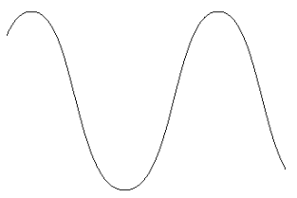
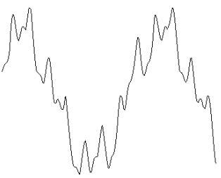
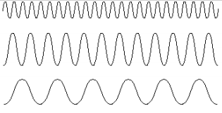

FOURIER TRANSFORM
Frequency domain: Joseph Fourier (1807).
Cannot provide simultaneously time and frequency information.
$$F\left(ω\right)=\int{f\left(t\right)e^{−jωt}dt}$$
$$f(t)=\frac{1}{2π}\int{F(ω)e^{jωt}dω}$$
Frequency = rate of change
High frequencies correspond to sharp edges, fine detail and noise
Low frequencies correspond to smoother and slower changes
Notes:
Transform: A mathematical operation that takes a function or sequence and maps it into another one.
The transform of a function may give additional/hidden information about the original function, which may not be available/obvious otherwise.
The transform of an equation may be easier to solve than the original equation.
The transform of a function/sequence may require less storage, hence provide data compression/reduction.
An operation may be easier to apply on the transformed function, rather than the original function (recall convolution).

Slide 4


FOURIER TRANSFORM
Recall that FT uses complex exponentials (sinusoids) as building blocks.
For each frequency of complex exponential, the sinusoid at that frequency is compared to the signal.
If the signal consists of that frequency, the correlation is high → large FT coefficients.
If the signal does not have any spectral component at a frequency, the correlation at that frequency is low / zero, → small / zero FT coefficient.
$$e^{jωt}=cos\left(ωt\right)+jsin\left(ωt\right)$$
$$F\left(ω\right)=\int{f\left(t\right)e^{−jωt}dt}$$
$$f(t)=\frac{1}{2π}\int{F(ω)e^{jωt}dω}$$

Slide 5
Stationary and Non-stationary Signals
FT identifies all spectral components present in the signal, however it does not provide any information regarding the temporal (time) localization of these components.
Stationary signals consist of spectral components that do not change in time
all spectral components exist at all times
no need to know any time information
FT works well for stationary signals
However, non-stationary signals consists of time varying spectral components
How do we find out which spectral component appears when?
FT only provides what spectral components exist, not where in time they are located.
Need some other ways to determine time localization of spectral components.
Notes:
Stationary signal: tín hiệu dừng

Slide 6
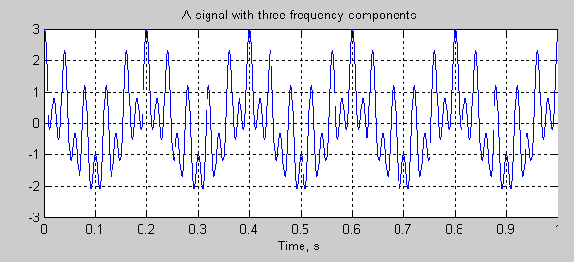
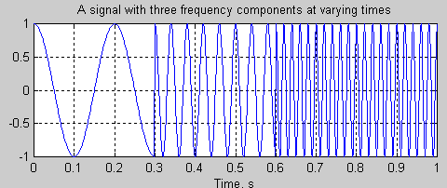
Stationary and Non-stationary Signals
Stationary signals’ spectral characteristics do not change with time
Non-stationary signals have time varying spectra
Concatenation

Slide 7
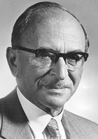

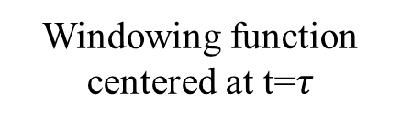

SHORT-TIME FOURIER TRANSFORM
Time-Frequency analysis:
STFT (Dennis Gabor 1946).
$$STFT\left\{x\left(t\right)\right\}\left\{τ,ω\right\}≡X\left(τ,ω\right)=\int_{−∞}^{∞}{x(t)ω\left(t−τ\right)e^{−jωt}dt}$$
Time
parameter
Frequency
parameter
Signal to
be analyzed
FT Kernel
(basis function)
STFT of signal x(t):
Computed for each
window centered at t=$τ$
Windowing
function
Windowing function
centered at t=$τ$

Slide 8
SHORT-TIME FOURIER TRANSFORM
Wide analysis window ➔ poor time resolution, good frequency resolution.
Narrow analysis window ➔ good time resolution, poor frequency resolution.
Notes:
Choose a window function of finite length
Put the window on top of the signal at t=0
Truncate the signal using this window
Compute the FT of the truncated signal, save.
Slide the window to the right by a small amount
Go to step 3, until window reaches the end of the signal
For each time location where the window is centered, we obtain a different FT
Hence, each FT provides the spectral information of a separate time-slice of the signal, providing simultaneous time and frequency information

Slide 9
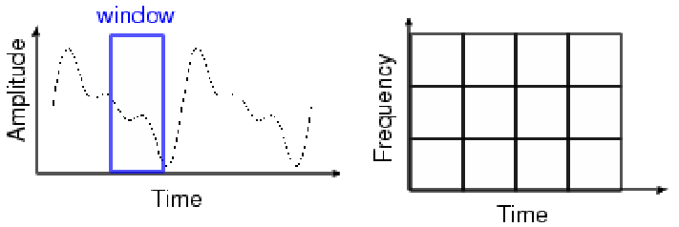
SHORT-TIME FOURIER TRANSFORM
Once the window is chosen, the resolution is set for both time and frequency.
Notes:
Choose a window function of finite length
Put the window on top of the signal at t=0
Truncate the signal using this window
Compute the FT of the truncated signal, save.
Slide the window to the right by a small amount
Go to step 3, until window reaches the end of the signal
For each time location where the window is centered, we obtain a different FT
Hence, each FT provides the spectral information of a separate time-slice of the signal, providing simultaneous time and frequency information

Slide 10
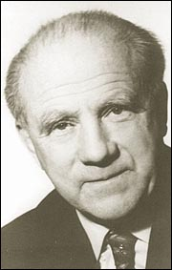
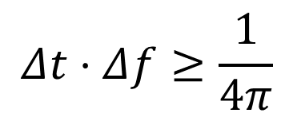
Heisenberg Uncertainty Principle
$$Δt⋅Δf≥\frac{1}{4π}$$
Time resolution: How well two spikes in time can be separated from each other in the transform domain
Frequency resolution: How well two spectral components can be separated from each other in the transform domain
Both time and frequency resolutions cannot be arbitrarily high!!! ➔ ➔We cannot precisely know at what time instance a frequency component is located. We can only know what interval of frequencies are present in which time intervals

Slide 11
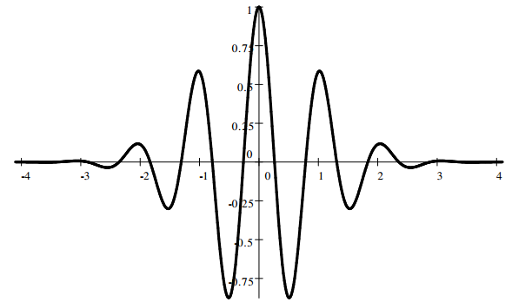
WAVELET TRANSFORM
Wavelets are mathematical functions.
Wavelet Transform: Decomposition of a signal into constituent parts.
Notes:
Fourier series: harmonic sinusoids; single integer index
Fourier transform (FT): nonharmonic sinusoids; single real index
Walsh decomposition: “harmonic” square waves; single integer index
Karhunen-Loeve decomp: eigenfunctions of covariance; single real index
Short-Time FT (STFT): windowed, nonharmonic sinusoids; double index
Wavelet Transform: time-compacted waves; double index

Slide 12
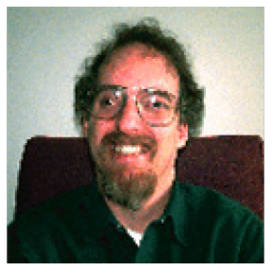
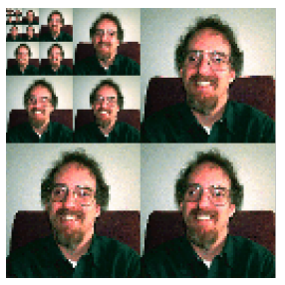
WAVELET TRANSFORM
Principles of wavelet transform:
Split up the signal into a bunch of signals.
Representing the same signal, but all corresponding to different frequency bands.
Providing what frequency bands exists at what time intervals.
Input image (2^{N}x2^{N})
Transformed image (2^{N}x2^{N})
wavelet
transform
Notes:
Fourier series: harmonic sinusoids; single integer index
Fourier transform (FT): nonharmonic sinusoids; single real index
Walsh decomposition: “harmonic” square waves; single integer index
Karhunen-Loeve decomp: eigenfunctions of covariance; single real index
Short-Time FT (STFT): windowed, nonharmonic sinusoids; double index
Wavelet Transform: time-compacted waves; double index

Slide 13
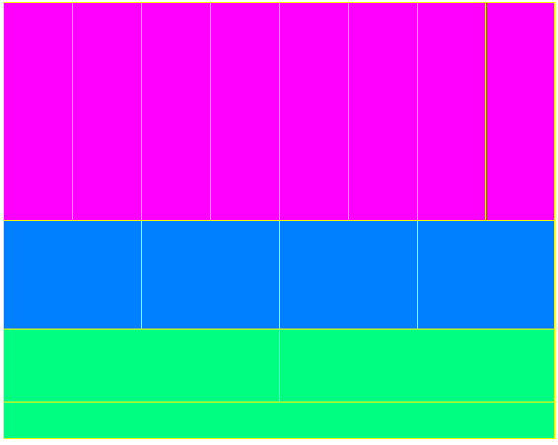
WAVELET TRANSFORM
Better time resolution;
Poor frequency resolution
Frequency
Better frequency resolution;
Poor time resolution
Time
Each box represents a equal portion
Resolution in STFT is selected once for entire analysis

Slide 14
WAVELET TRANSFORM
Overcomes the preset resolution problem of the STFT by using a variable length window.
Analysis windows of different lengths are used for different frequencies:
Analysis of high frequencies ➔ Use narrower windows for better time resolution.
Analysis of low frequencies ➔ Use wider windows for better frequency resolution.
This works well, if the signal to be analyzed mainly consists of slowly varying characteristics with occasional short high frequency bursts.
Heisenberg principle still holds!!!
The function used to window the signal is called the wavelet.

Slide 15
WAVELET TRANSFORM
Wavelet transform also provides time-frequency view
Decomposes signal in terms of duration-limited, band-pass components
High-frequency components are short-duration, wide-band
Low-frequency components are longer-duration, narrow-band
Can provide combo of good time-frequency localization and orthogonality
The STFT can’t do this
More precisely, wavelets give time-scale viewpoint
This is connected to the multi-resolution viewpoint of wavelets
Notes:
Orthogonality means that a representation of a signal in terms of sinusoidal waveforms leads to a “least squares” problem, i.e. with a finite number of terms we have the best approximation of a given signal in the least square sense.
Orthogonality also means that if we take a finite number of terms in an approximate representation, and we wish to take one more term then the previously calculated weighting coefficients remain unaffected.

Slide 16
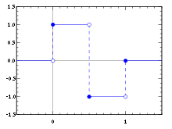
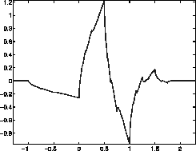
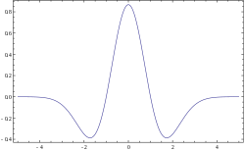
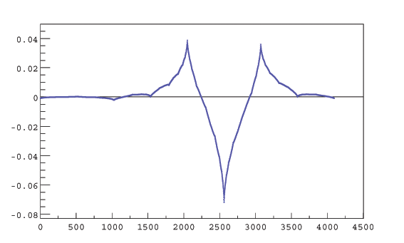
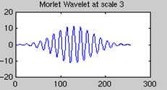
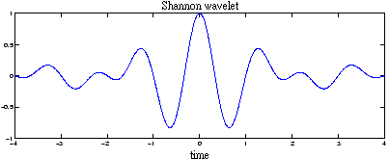
TYPES OF WAVELET
Daubechies
Haar
Mexican hat
Shannon
Bi-orthogonal CDF44
Morlet

Slide 17

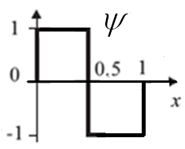
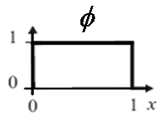
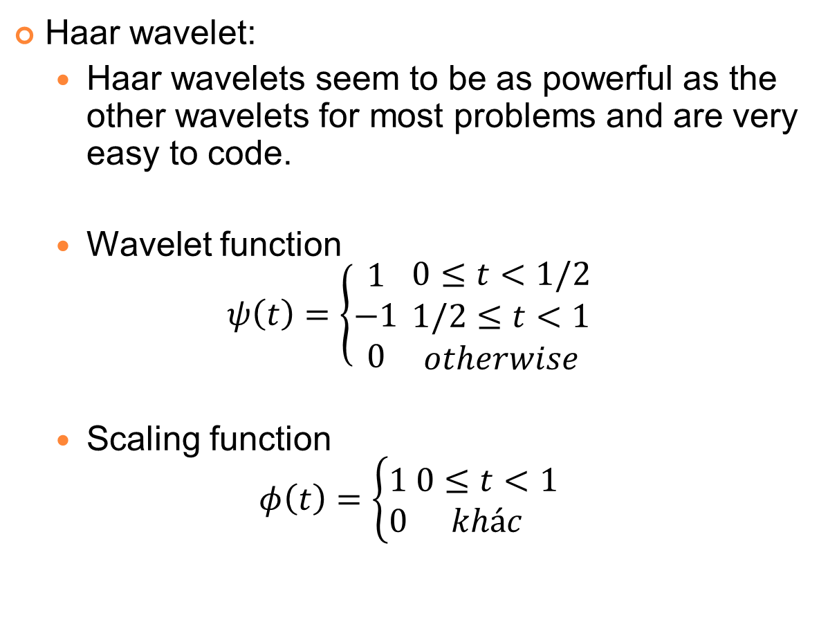
TYPES OF WAVELET
Haar wavelet:
Haar wavelets seem to be as powerful as the other wavelets for most problems and are very easy to code.
Wavelet function
$$ψ\left(t\right)=\left\{\begin{aligned}1 \\ −1 \\ 0\end{aligned} \right.\begin{matrix}0≤t<1/2 \\ 1/2≤t<1 \\ otherwise\end{matrix}$$
Scaling function
$$φ\left(t\right)=\left\{\begin{aligned}1 \\ 0\end{aligned} \begin{matrix}0≤t<1 \\ khác\end{matrix}\right.$$

Slide 18
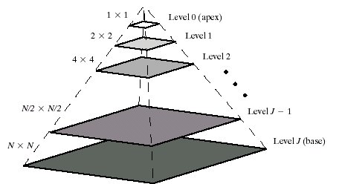
Image Pyramids
Compute a reduced-resolution approximation of the input image
Filtering (Averaging, Gaussian)
Down-sampling
Up-sample the output of the previous by a factor 2
Compute the difference between the prediction of step 2 and the input to Step 1.
Coarser, decrease resolution
Finer, increase resolution
Notes:
Upsampling (or interpolation) is done by zero inserting between every two coefficients.

Slide 19
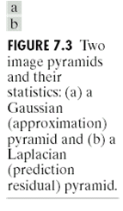
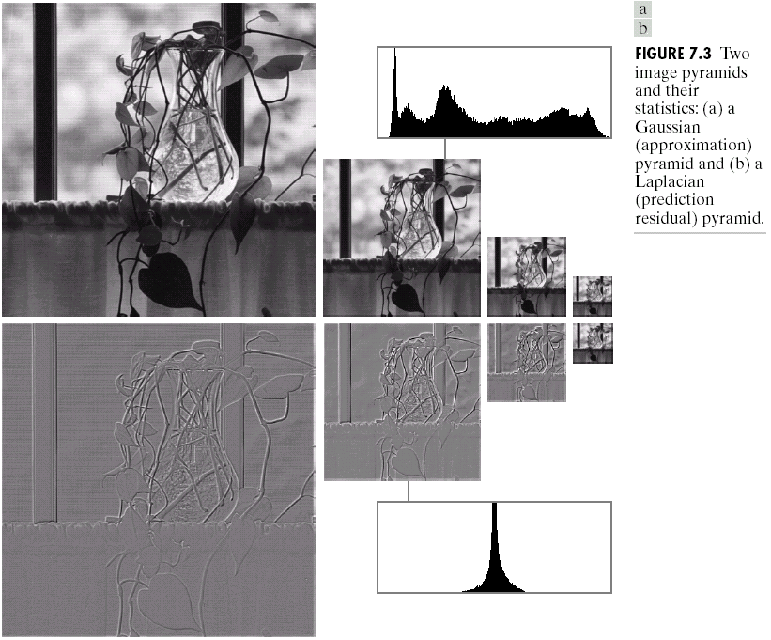
Image Pyramids

Slide 20

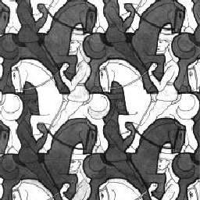
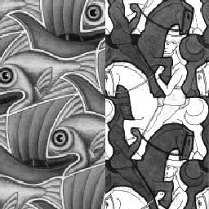
Image Pyramids
Compression
Capture important structures with fewer bytes
Denoising
Model statistics of pyramid sub-bands
Image blending
Notes:
Upsampling (or interpolation) is done by zero inserting between every two coefficients.

Slide 21
Subband Coding
If we regard the wavelet transform as a filter bank, then we can consider wavelet transforming a signal as passing the signal through this filter bank.
The outputs of the different filter stages are the wavelet- and scaling function transform coefficients.
In general we will refer to this kind of analysis as a multiresolution.
That is called subband coding.

Slide 22
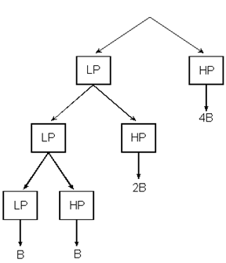
Subband Coding
Splitting the signal spectrum with an iterated filter bank.
8B
f
LP
4B
HP
4B
f
LP
HP
4B
f
2B
2B
LP
HP
2B
4B
f
B
B
Summarizing, if we implement the wavelet transform as an iterated filter bank, we do not have to specify the wavelets explicitly.

Slide 23
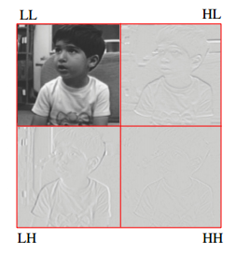
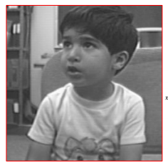
Subband Coding - Application
Most audio codecs today uses subband coding
Human ears can be modeled by a filter bank of 25 overlapping bands
Some researchers try to apply subband coding on images and videos, but not very successful
Key issue: cascaded 2-D decomposition using separable 1-D filters is not very meaningful
Subband Coding

Slide 24
MULTIRESOLUTION ANALYSIS
In Multi-resolution Analysis (MRA)
A Scaling Function is used to create a series of approximations of a function or image, each differing by a factor 2 from its nearest neighboring approximations.
Additional functions, called Wavelet, are used to encode the difference in information between adjacent approximation.

Slide 25
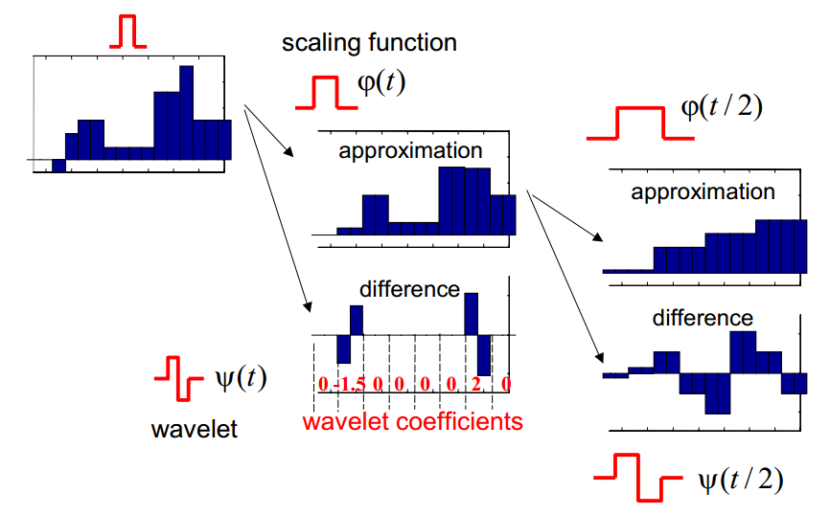
MULTIRESOLUTION ANALYSIS

Slide 26
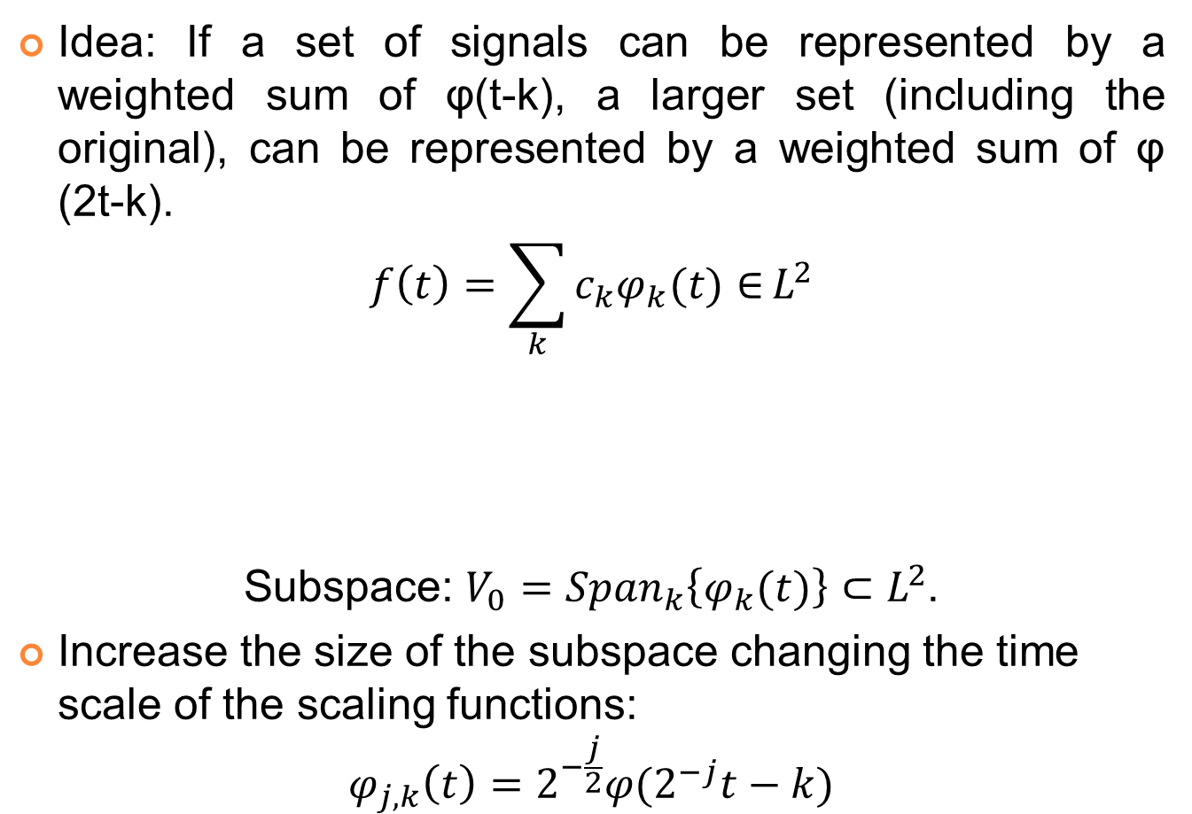
MULTIRESOLUTION ANALYSIS
Idea: If a set of signals can be represented by a weighted sum of φ(t-k), a larger set (including the original), can be represented by a weighted sum of φ (2t-k).
$$f\left(t\right)=\sum_{k}{c_{k}φ_{k}(t)∈}L^{2}$$
Subspace: $V_{0}={Span}_{k}\left\{φ_{k}(t)\right\}⊂L^{2}$.
Increase the size of the subspace changing the time scale of the scaling functions:
$$φ_{j,k}\left(t\right)=2^{−\frac{j}{2}}φ(2^{−j}t−k)$$
Real-valued expansion coefficients
Real-valued expansion functions

Slide 27
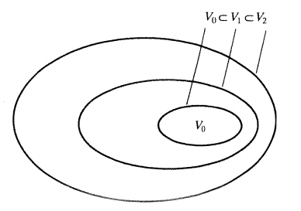

MULTIRESOLUTION ANALYSIS
The spanned spaces are nested:
$$V_{j}=Span\left\{φ_{k}(2^{j}t)\right\}=Span\left\{φ_{j,k}(t)\right\}∈L^{2}$$
$$V_{−∞}⊂…⊂V_{−1}⊂V_{0}⊂V_{1}⊂V_{2}⊂…{⊂V}_{+∞}$$
Wavelets span the differences between spaces w_{i}.
Wavelets and scaling functions should be orthogonal: simple calculation of coefficients.
Nested function spaces spanned by a scaling function

Slide 28
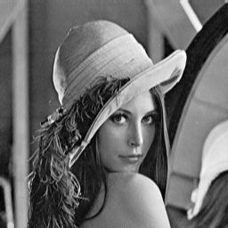




MULTIRESOLUTION ANALYSIS
V₃
V₂
V₁
V₀
V₋₁
V₋₂
V₋₃

Slide 29

Haar Wavelet Transform - Example
Suppose we are given the following input sequence.
{x_{n,i}} = {10, 13, 25, 26, 29, 21, 7, 15}
Consider the transform that replaces the original sequence with its pairwise average x_{n−1,i} and difference d_{n−1,i} defined as follows:
$$x_{n−1,i}=\frac{x_{n,2i}+x_{n,2i+1}}{2}$$
$$d_{n−1,i}=\frac{x_{n,2i}−x_{n,2i+1}}{2}$$

Slide 30
Haar Wavelet Transform - Example
Analysis
10 | 13 | 25 | 26 | 29 | 21 | 7 | 15
Input image
11.5 | 25.5 | 25 | 11
-1.5 | -0.5 | 4 | -4
Detail coefs D²
18.5 | 18
-7 | 7
Detail coefs D¹
18.25
0.25
Detail coefs D⁰

Slide 31
Haar Wavelet Transform - Example
10 | 13 | 25 | 26 | 29 | 21 | 7 | 15
Input image
D⁰
D¹
D²
18.25 | 0.25 | -7 | 7 | -1.5 | -0.5 | 4 | -4
Wavelet transform image

Slide 32
Haar Wavelet Transform - Example
The averages and differences are applied only on consecutive pairs of input sequences whose first element has an even index.
The number of elements in each set {x_{n−1,i}} and {d_{n−1,i}} is exactly half of the number of elements in the original sequence.
Form a new sequence having length equal to that of the original sequence by concatenating the two sequences {x_{n−1,i} } and {d_{n−1,i}}. The resulting sequence is
{x_{n,i}, d_{n-1,i}} = {11.5, 25.5, 25, 11, −1.5, −0.5, 4, −4}

Slide 33
Haar Wavelet Transform - Example
This sequence has exactly the same number of elements as the input sequence - the transform did not increase the amount of data.
Since the first half of the above sequence contain averages from the original sequence, we can view it as a coarser approximation to the original signal.
The second half of this sequence can be viewed as the details or approximation errors of the first half.

Slide 34
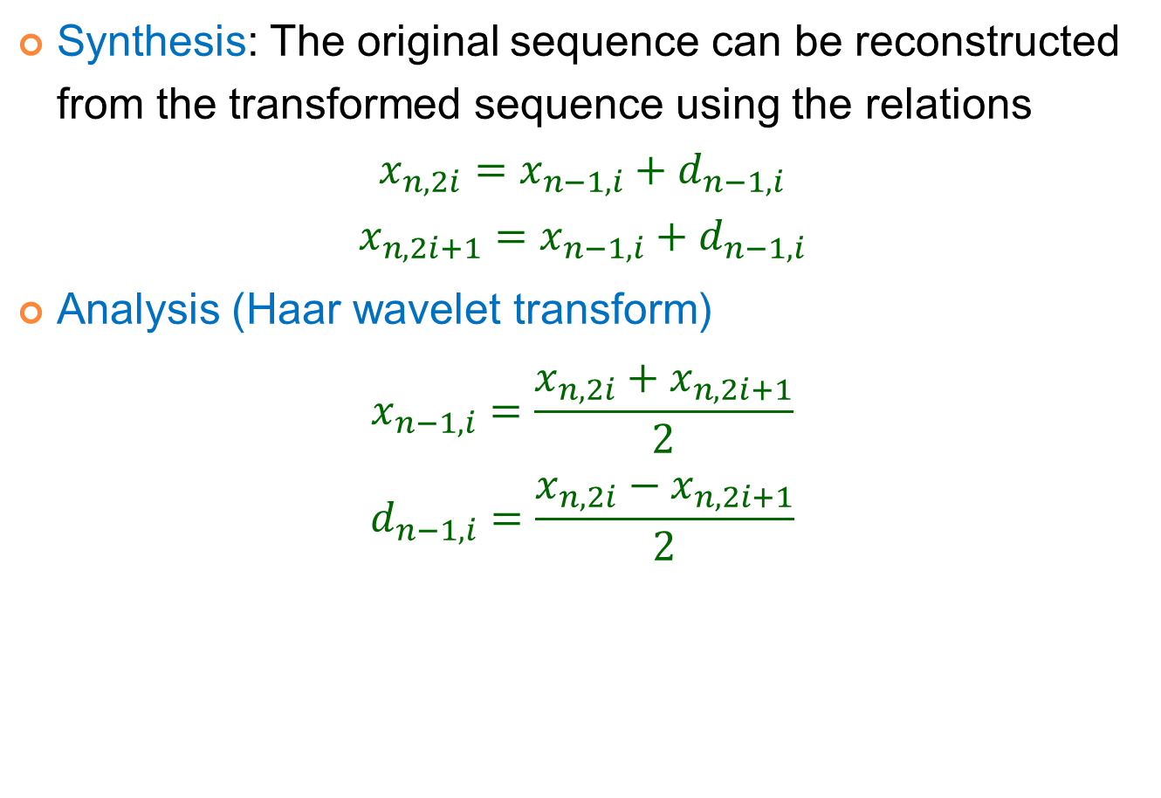
Haar Wavelet Transform - Example
Synthesis: The original sequence can be reconstructed from the transformed sequence using the relations
$$x_{n,2i}=x_{n−1,i}+d_{n−1,i}$$
$$x_{n,2i+1}=x_{n−1,i}+d_{n−1,i}$$
Analysis (Haar wavelet transform)
$$x_{n−1,i}=\frac{x_{n,2i}+x_{n,2i+1}}{2}$$
$$d_{n−1,i}=\frac{x_{n,2i}−x_{n,2i+1}}{2}$$

Slide 35
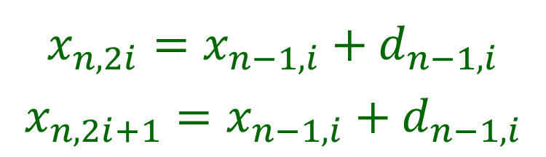
Haar Wavelet Transform - Example
$$x_{n,2i}=x_{n−1,i}+d_{n−1,i}$$
$$x_{n,2i+1}=x_{n−1,i}+d_{n−1,i}$$
Synthesis
10 | 13 | 25 | 26 | 29 | 21 | 7 | 15
11.5 | 25.5 | 25 | 11 | -1.5 | -0.5 | 4 | -4
18.5 | 18 | -7 | 7 | -1.5 | -0.5 | 4 | -4
18.25 | 0.25 | -7 | 7 | -1.5 | -0.5 | 4 | -4

Slide 36
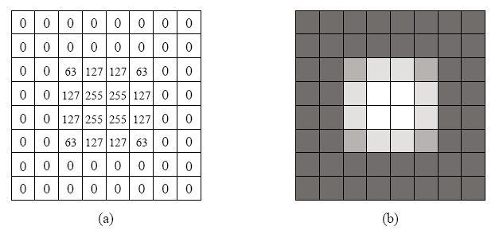
Haar Wavelet Transform - Example
Input image for the 2D Haar Wavelet Transform.
(a) The pixel values. (b) Shown as an 8×8 image.

Slide 37
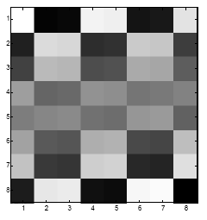
Haar Wavelet Transform - Example
33 | 32 | 33 | 32 | 31 | -29 | 27 | -25
32.5 | 32.5 | 0.5 | 0.5 | 31 | -29 | 27 | -25
32.5 | 0 | 0.5 | 0.5 | 31 | -29 | 27 | -25

Slide 38
Haar Wavelet Transform - Example
Appling on rows
detail coefficients
row average

Slide 39
Haar Wavelet Transform - Example
Appling on columns

Slide 40
Haar Wavelet Transform - Example
Appling on columns
Choose a threshold δ
δ = 5

Slide 41
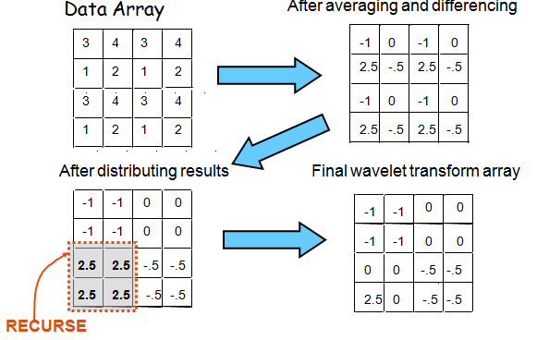
Example Decomposition Of a 4×4 Array

Slide 42
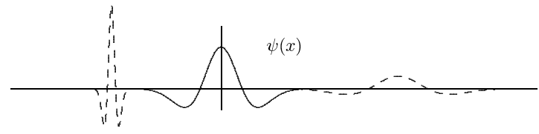
CONTINUOUS WAVELET TRANSFORM
The continuous wavelet transform is the sum over all time of the signal multiplied by scaled, shifted versions of the wavelet. This process produces wavelet coefficients that are a function of scale and position.

Slide 43

CONTINUOUS WAVELET TRANSFORM
Width of the window is changed as the transform is computed for every spectral components.
$$W_{x;ψ}\left(τ,s\right)=\frac{1}{\sqrt{\left|s\right|}}\int_{−∞}^{∞}{f(t)∙ψ^{∗}\left(\frac{t−τ}{s}\right)}dt$$
$τ$: translation (the location of the window)
$s$: scale
$ψ^{∗}$: mother wavelet
$∗$ denotes complex conjugation

Slide 44
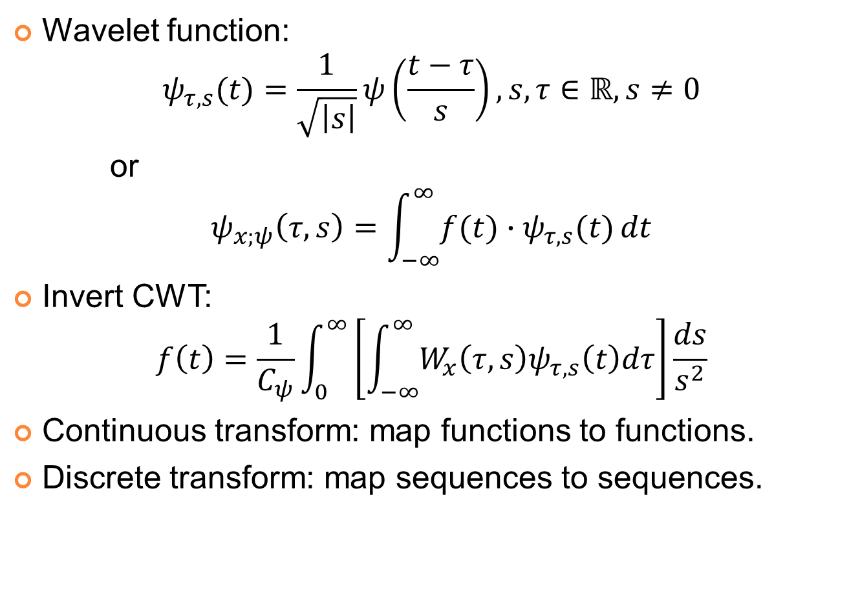
CONTINUOUS WAVELET TRANSFORM
Wavelet function:
$$ψ_{τ,s}(t)=\frac{1}{\sqrt{\left|s\right|}}ψ\left(\frac{t−τ}{s}\right), s,τ∈ℝ,s≠0$$
or
$$ψ_{x;ψ}\left(τ,s\right)=\int_{−∞}^{∞}{f(t)∙ψ_{τ,s}(t)}dt$$
Invert CWT:
$$f\left(t\right)=\frac{1}{C_{ψ}}\int_{0}^{∞}{\left[\int_{−∞}^{∞}{W_{x}\left(τ,s\right)ψ_{τ,s}\left(t\right)dτ}\right]}\frac{ds}{s^{2}}$$
Continuous transform: map functions to functions.
Discrete transform: map sequences to sequences.

Slide 45
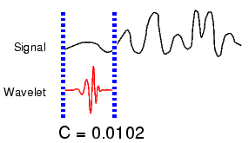
CONTINUOUS WAVELET TRANSFORM
Five Easy Steps to a Continuous Wavelet Transform
Take a wavelet and compare it to a section at the start of the original signal.
Calculate a number, C, that represents how closely correlated the wavelet is with this section of the signal. The higher C is, the more the similarity. Note that the results will depend on the shape of the wavelet you choose.

Slide 46
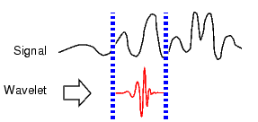

CONTINUOUS WAVELET TRANSFORM
Five Easy Steps to a Continuous Wavelet Transform
Shift the wavelet to the right and repeat steps 1 and 2 until you've covered the whole signal.
Scale (stretch) the wavelet and repeat steps 1 through 3.
Repeat steps 1 through 4 for all scales

Slide 47

Fourier vs. Wavelet
Fourier vs Wavelet transform
From http://www.cerm.unifi.it/EUcourse2001/Gunther_lecturenotes.pdf, p.10
Notes:
FFT, basis functions: sinusoids
Wavelet transforms: small waves, called wavelet
FFT can only offer frequency information
Wavelet: frequency + temporal information
Fourier analysis doesn’t work well on discontinuous, “bursty” data: music, video, power, earthquakes,…

Slide 48

Fourier vs. Wavelet

Slide 49
Fourier vs. Wavelet
Fourier
Loses time (location) coordinate completely
Analyses the whole signal
Short pieces lose “frequency” meaning
Wavelets
Localized time-frequency analysis
Short signal pieces also have significance
Scale = Frequency band

Slide 50

DISCREET WAVELET TRANSFORM
DWT was built by Mallat as multi-resolution analysis.
Using Multiresolution Analysis.
$$W_{φ}\left(j_{0},k\right)=\frac{1}{\sqrt{M}}\sum_{x}{f\left(x\right)}φ_{j_{0},k}(x)$$
$$W_{φ}\left(j,k\right)=\frac{1}{\sqrt{M}}\sum_{x}{f\left(x\right)}φ_{j,k}(x)$$
Invert DWT:
$$f\left(x\right)=\frac{1}{\sqrt{M}}\sum_{k}{W_{φ}\left(j_{0},k\right)φ_{j_{0},k}\left(x\right)+}\frac{1}{\sqrt{M}}\sum_{j=j_{0}}^{∞}{W_{φ}\left(j,k\right)}φ_{j,k}(x)$$
scaling function
wavelet function
Normalized factor

Slide 51
DISCREET WAVELET TRANSFORM
In the discrete signal case we compute the Discrete Wavelet Transform by successive low pass and high pass filtering of the discrete time-domain signal. This is called the Mallat algorithm or Mallat-tree decomposition.
Unfortunately, if we actually perform this operation on a real digital signal, we wind up with twice as much data as we started with. Suppose, for instance, that the original signal S consists of 1000 samples of data. Then the approximation and the detail will each have 1000 samples, for a total of 2000.
To correct this problem, we introduce the notion of downsampling. This simply means throwing away every second data point.
Notes:
Since each filter output has smaller bandwidth, we can discard some samples without losing information; this is called down-sampling or decimation.

Slide 52

DISCREET WAVELET TRANSFORM
downsampling
DWT filter bank
g[n]: lowpass filter, scaling function
h[n]: highpass filter, wavelet function

Slide 53
Pyramidal Wavelet Decomposition

Slide 54
DISCREET WAVELET TRANSFORM
Wavelet transforms
Low pass filtering: averaging
High pass filtering: differencing
Input data: a, b
Average: s = (a + b) / 2 (low pass filtering)
Difference: d = a – s (high pass filtering)
Wavelet coefficients: (s, d).
Inverse wavelet transforms: addition; subtraction
Wavelet coefficients: (s, d).
Addition: s + d = s + (a – s) = a,
Subtraction: s – d = s – (a – s) = 2s – a = b
Input data: (a, b).

Slide 55
DISCREET WAVELET TRANSFORM
Example: input data 14, 22
Wavelet Transform
Average: s = (14＋22)/2 = 18,
Difference: d = 14-18= -4
Wavelet coefficients: (18, -4).
Inverse Wavelet Transform (to recover the input data)
s ＋ d = 18+(-4) = 14,
s － d = 18-(-4) = 22
Input data: (14, 22).

Slide 56
DISCREET WAVELET TRANSFORM
Compression algorithms using DWT
Embedded zero-tree (EZW)
Use DWT for the decomposition of an image at each level.
Scans wavelet coefficients subband by subband in a zigzag manner.
Set partitioning in hierarchical trees (SPHIT)
Highly refined version of EZW.
Perform better at higher compression ratio for a wide variety of images than EZW.
Zero-tree entropy (ZTE)
Quantized wavelet coefficients into wavelet trees to reduce the number of bits required to represent those trees.
Quantization is explicit instead of implicit, make it possible to adjust the quantization according to where the transform coefficient lies and what it represents in the frame.
Coefficient scanning, tree growing, and coding are done in one pass.
Coefficient scanning is a depth first traversal of each tree.

Slide 57
CWT vs. DWT
 | CWT | DWT
1. Scale | At any scale | Dyadic scales
2. Translation | At any point | Integer point
3. Wavelet | Any wavelet that satisfies minimum criteria | Orthogonal, biorthogonal, …
4. Computation | Large | Small
5. Detection | Easily detects direction, orientation | Cannot detect minute object if not finely tuned
6. Application | Pattern Recognition Feature extraction Detection | Compression De-noising Transmission Characterization

Slide 58
WAVELET PACKET
In the usual dyadic wavelet decomposition (transform), only the low-pass filtered subband is recursively decomposed and thus can be represented by a logarithmic tree structure.
A wavelet packet decomposition allows the decomposition to be represented by any pruned subtree of the full tree topology.
The wavelet packet decomposition is very flexible.

Slide 59

WAVELET PACKET
The cost of this generalization is an image in computational complexity from O(M) for FWT to O(M log M).
A three-scale wavelet packet analysis tree

Slide 60
Applied Fields Using Wavelets
Astronomy
Acoustics
Nuclear engineering
Sub-band coding
Signal and Image processing
Neurophysiology
Music
Magnetic resonance imaging
Speech discrimination
Optics
Fractals
Turbulence
Earthquake-prediction
Radar
Human vision
Pure mathematics applications such as solving partial differential equations

Slide 61
WAVELET TRANSFORM APPLICATION
Compress image: JPEG 2000
Compress video
Compress speech/audio
Store digital Fingerprints
Fingerprints authentication
Reduce noise
Edge detection
…

Slide 62
WAVELET TRANSFORM APPLICATION
Computer and Human Vision
Goal: Artificial vision for robots
Marr Wavelet: intensity changes at different scales in an image.
Image processing in the human has hierarchical structure of layers of processing.
FBI Fingerprint Compression
Goal: Compression of 6MB for pair of hands.
Choose the best wavelets.
Truncate coefficients below a threshold.
Sparse coding makes wavelets valuable tool in data compression.

Slide 63
WAVELET TRANSFORM APPLICATION
Denoising Noisy Data
Goal: Recovering a true signal from noisy data.
Wavelet shrinkage and Thresholding methods.
Signal is transformed using Coiflets, thresholded and inverse-transformed.
No smoothing of sharp structures required, one step forward.
Musical Tones
Goal: Sound synthesis.
Notes from instrument decomposed into wavelet packet coefficients.
Reproducing the note requires reloading those coefficients into wavelet packet generator.
Wavelet-packet-based music synthesizer.

Slide 64
Wavelets in Image Coding
Orthogonal vs. Biorthogonal:
JPEG 2000 uses biorthogonal filters
Lossless and lossy compression
Cohen-Daubechies-Feavau filters 9/7
CDF 5/3 for lossless compression (integer)
Filters are symmetric/anti-symmetric
Nearly orthogonal
Symmetric extensions of the input data
Common Wavelet Filters
Haar: simplest, orthogonal, not very good
Daubechies 8/8: orthogonal
Daubechies 9/7: bi-orthogonal, most commonly used if numerical reconstruction errors are acceptable.
LeGall 5/3: bi-orthogonal, integer operation, can be implemented with integer operations only, used for lossless image coding.

Slide 65
Wavelet Transform Coding for Image Compression
Encoder
Input image
(NxN)
Wavelet
transform
Symbol
encoder
Quantizer
Compressed
image
Decoder
Decompressed
image
Inverse
wavelet
transform
Symbol
decoder
Unlike DFT and DCT, Wavelet transform is a multiresolution transform.

Slide 66
Steps in JPEG 2000
Tiling: The image is split into tiles, rectangular regions of the image that are transformed and encoded separately. Tiles can be any size. Dividing the image into tiles is advantageous in that the decoder will need less memory to decode the image and it can opt to decode only selected tiles to achieve a partial decoding of the image. Using many tiles can create a blocking effect.
Wavelet Transform: Either CDF 9/7 or CDF 5/3 biorthogonal wavelet transform.
Quantization: Scalar quantization
Coding: The quantized subbands are split into precincts, rectangular regions in the wavelet domain. They are selected in a way that the coefficients within them across the sub-bands form approximately spatial blocks in the image domain. Precincts are split further into code blocks. Code blocks are located in a single sub-band and have equal sizes. The encoder has to encode the bits of all quantized coefficients of a code block, starting with the most significant bits and progressing to less significant bits by EBCOT scheme.
Notes:
EBCOT: embedded block coding with optimized truncation

Slide 67
DWT in JPEG 2000
Step 1:
A | B | C | D |  | A+B | C+D | A-B | C-D
 |  |  |  |  | L |  | H
20 | 15 | 30 | 20 |  | 35 | 50 | 5 | 10
17 | 16 | 31 | 22 |  | 33 | 53 | 1 | 9
15 | 18 | 17 | 25 |  | 33 | 42 | -3 | -8
21 | 22 | 19 | 18 |  | 43 | 37 | -1 | 1
Original image O
1st horizontal separation

Slide 68
DWT in JPEG 2000
Step 2:
A |  | C |  |  | A+B |  | C+D
B |  | D |  |  | LL |  | HL
L |  | H |  |  | A-B |  | C-D
 |  |  |  |  | LH |  | HH
35 | 50 | 5 | 10 |  | 68 | 103 | 6 | 19
33 | 53 | 1 | 9 |  | 76 | 79 | -4 | -7
33 | 42 | -3 | -8 |  | 2 | -3 | 4 | 1
43 | 37 | -1 | 1 |  | -10 | 5 | -2 | -9
1st horizontal separation
1st vertical separation

Slide 69
DWT in JPEG 2000
LL1 | HL1 |  | LL2 | HL2 | HL1
 |  |  | LH2 | HH2
LH1 | HH1 |  | LH1 |  | HH1
First level
Second level
LL3 | HL3 | HL2 | HL1
LH3 | HH3
LH2 |  | HH2
LH1 |  |  | HH1
Most important part of the image
Third level

Slide 70
DWT in JPEG 2000
LL3 | HL3 | HL2 | HL1
LH3 | HH3
LH2 |  | HH2
LH1 |  |  | HH1
68 | 103 | 6 | 19 |  | 326 | -38 | 6 | 19
76 | 79 | -4 | -7 |  | 16 | -32 | 2 | -7
2 | -3 | 4 | 1 |  | 2 | -3 | 4 | 1
-10 | 5 | -2 | -9 |  | -10 | 5 | -2 | -9
1st vertical separation
2nd level DWT result

Slide 71

DWT in JPEG 2000

Slide 72

DWT in JPEG 2000

Slide 73



DWT in JPEG 2000
Level 1
Level 2

Slide 74



JPEG2000 vs JPEG

Slide 75





DWT vs. DCT
98% Wavelet Compression
98% DCT Compression
Original Image

Slide 76
DEMO
Haar wavelet transform
Compress image (with iteration)
Reduce noise (with threshold)
Wavelet transform on depth image
Wavelet transform on RGD-D image
Dataset
"Standard" test images (http://www.imageprocessingplace.com/root_files_V3/image_databases.htm)
IEEE International Conference on Robotics and Automation (ICRA) (http://rgbd-dataset.cs.washington.edu)
VOCB3DO, Berkeley 3-D Object Dataset (http://kinectdata.com)
NYU Depth Dataset V2 (http://cs.nyu.edu/~silberman/datasets/nyu_depth_v2.html)
Notes:
"Standard" test images (a set of images found frequently in the literature: Lena, peppers, cameraman, lake, etc., all in uncompressed tif format and of the same 512 x 512 size).

Slide 77
CONCLUSION
Wavelet transform provides what frequency bands exists at what time intervals.
Provides Orthonormal bases while STFT does not.
Provides a multi-resolution signal analysis approach.
Wavelet-based processing algorithms were superior….Ability of wavelets to discriminate different frequencies and to preserve signal details at different resolutions.
Notes:
Hyperspectral Imagery Compression Using Three Dimensional Discrete Transforms (Tong Qiao)

Slide 78
CONCLUSION
Continuous Wavelet Transform
Pros
Using wavelets we overcome background estimation
Wavelets are resistant to noise (robust)
Cons
Redundancy → slow speed of calculations
Nonorthogonality (signal distotrs after inverse transform)
3D DCT has great potential to produce better compression than 3D DWT.
The biggest disadvantage of the wavelet based coding technique is the problem of selecting basis function for a particular operation.
Notes:
3D DCT vs 3D DWT: Hyperspectral Imagery Compression Using Three Dimensional Discrete Transforms (Tong Qiao)

Slide 79
FUTURE WORK
Basic wavelet theory is now in the refinement stage
The refinement stage involves generalizations and extensions of wavelets, such as extending wavelet packet techniques.
Wavelet techniques have not been thoroughly worked out in applications such as practical data analysis where for example, discretely sampled time-series data might need to be analyzed.

Slide 80
REFERENCE
English:
Asim Bhatti, Saeid Nahavandi, Yakov Frayman: “3D depth estimation for visual inspection using wavelet transform modulus maxima”, Comput. Electr. Eng., Vol. 33, August 2006.
Keith G. Boyer, “The Fast Wavelet Transform”, Master thesis, DeVry Institute of Technology, 1995.
M. Sifuzzaman, M.R. Islam, M.Z. Ali: “Application of Wavelet Transform and its Advantages Compared to Fourier Transform”, Vidyasagar University, 2009.
Rafael C. Gonzalez & R. E. Woods: “Digital Image Processing Third Edition”, Prentice Hall, ISBN 978-0131687288, pp. 483-543, 2006.
Richard Andrew Muyshondt: “Wavelet Transform In Image Compression”, Master thesis, Texas Tech University, 1995.
Richard Szeliski: “Computer Vision: Algorithms and Applications”, Springer, ISBN 978-1848829343, pp. 154-160, 2010.
Yu-Hong Lin, Te-Wei Chiang, Tienwei Tsai, Mann-Jung Hsiao: “Fast 3D image depth map estimation using wavelet analysis”, Audio Language and Image Processing (ICALIP), 2010.
Vietnamese:
Đỗ Ngọc Anh: “Nén ảnh sử dụng biến đổi wavelet và ứng dụng trong các dịch vụ dữ liệu đa phương tiện di động”, Đại học Bách Khoa Hà Nội, 2006.
Nguyễn Thị Lụa: “Nghiên cứu lý thuyết wavelet trong xử lý tín hiệu”, Đại học Bách Khoa Hà Nội, 2001.
Trần Duy Hưng: “Kỹ thuật xử lý ảnh sử dụng biến đổi Wavelet”, 2012.
Website:
http://en.wikipedia.org/wiki/Wavelet_transform
http://www.mathworks.com/help/wavelet/ug/wavelet-packets.html

Slide 81
THANK YOU!

